Slide 1

Soil sampling and monitoring
Mohit Kumar
Pratham Sahil
Priyanshu Mishra
Harshad Yugraj

Slide 2

Overview
Soil sampling is a crucial aspect of soil health monitoring, as it provides essential information about the soil's physical, chemical, and biological properties. Traditional soil sampling methods are manual, time-consuming, and often result in inconsistent and unreliable data. The need for a more efficient and accurate soil sampling system is crucial in ensuring sustainable agriculture and food security.
Project
We have developed an IoT-based soil sampling system that can accurately and efficiently collect soil samples, analyze the soil in real-time, and gives various parameters like moisture content, pH value, and temperature of soil so that people can choose the best soil for farming.

Slide 3
Description
Our loT-based soil sampling system consists of smart soil sampling devices equipped with loT sensors, a cloud-based platform for data storage and analysis, and a mobile application for real-time monitoring and management of soil health parameters.
The system is easy to install, operate, and maintain, and provides consistent and reliable data on soil health parameters such as pH, temperature, and moisture.

Slide 4
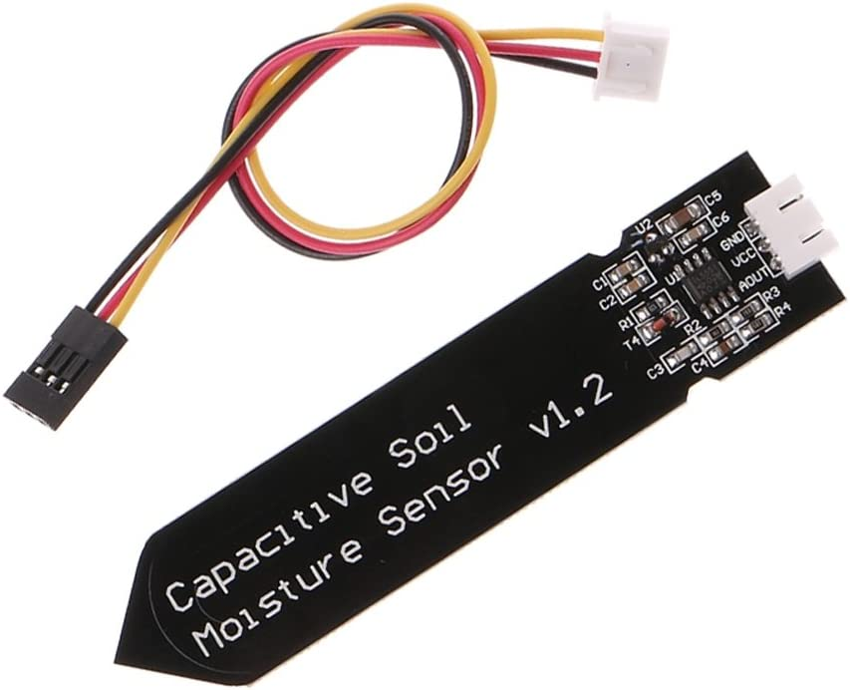
Sensors used
A capacitive soil moisture sensor
This Capacitive soil moisture sensor measures the volumetric content of water inside the soil and gives us the moisture level as output. It is made of corrosion-resistant material, providing excellent service life.
This module has an operating voltage range of 3.3 ~ 5.5V. It supports a 3-pin interface, i.e., Input Voltage, Ground, and Output pin.

Slide 5
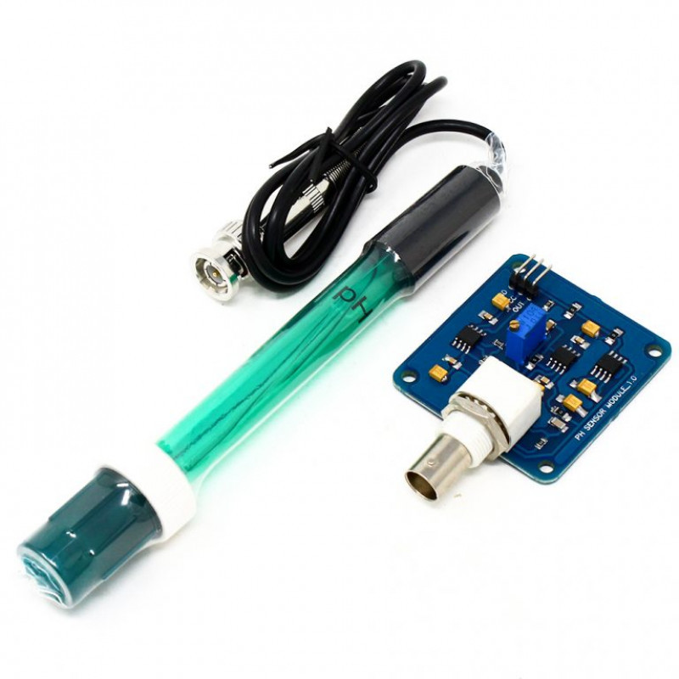
Sensors used
A pH sensor
This analog pH Sensor Kit is specially designed for microcontrollers. It has an LED that works as the Power Indicator, a BNC connector, and a PH2.0 sensor interface. To use it, we connected the pH sensor with the BND connector and plugged the PH2.0 interface into the analog input port of our microcontroller.

Slide 6
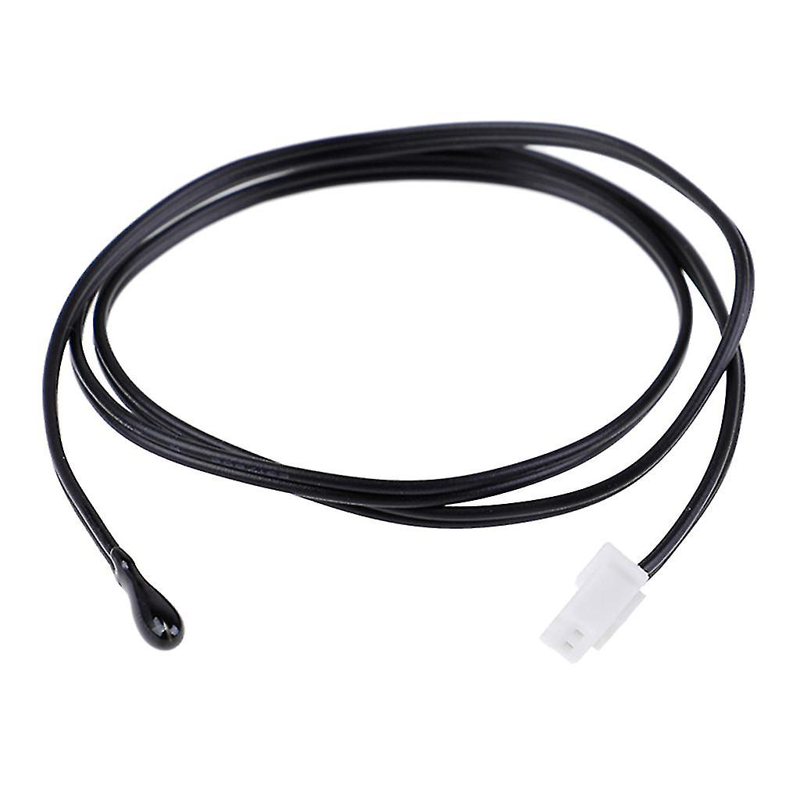
Sensors used
A temperature sensor
The thermistor is a temperature sensor that uses a semiconductor and measures the temperature and sends this information in terms of resistance value. It is able to record the slightest temperature changes.

Slide 7
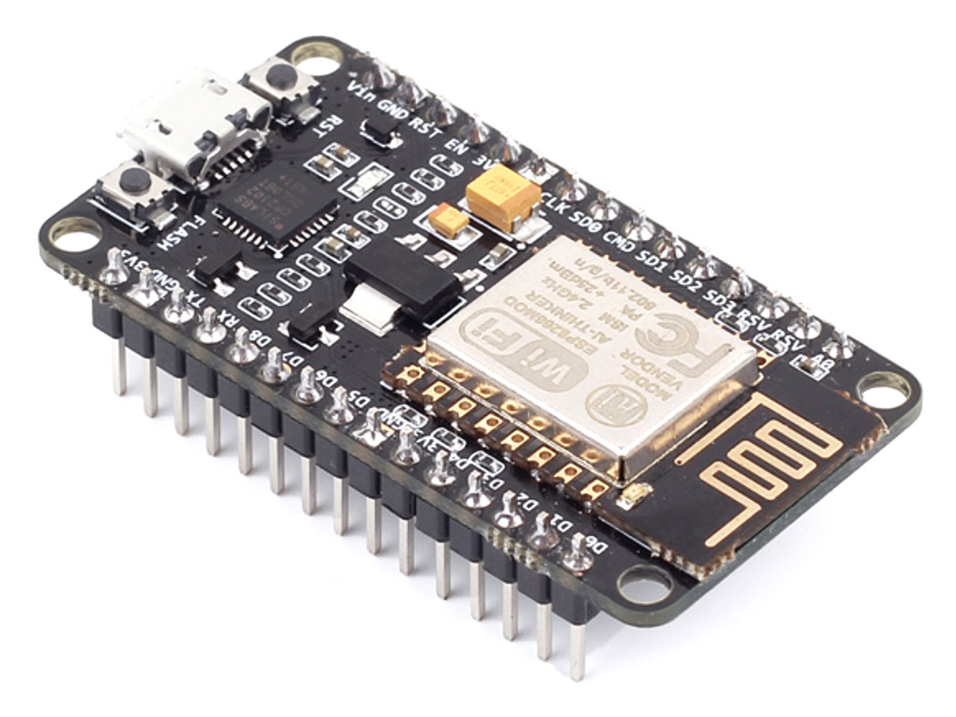
Board used
NodeMCU Esp8266
The ESP8266 is a low-cost Wi-Fi microchip with built-in TCP/IP networking software and microcontroller capability. The ESP8266 WiFi Module is a self-contained SOC with an integrated TCP/IP protocol stack that can give any microcontroller access to your WiFi network. The ESP8266 can host an application or offload all WiFi networking functions from another processor. Each ESP8266 module comes pre-programmed with an AT command set firmware, meaning we can simply hook this up to our Arduino device and get about as much WiFi-ability as a WiFi Shield offers. It has 17 GPIO pins, a serial peripheral interface bus(SPI), and a 10-bit ADC, making it easy to use.
This Photo by Unknown Author is licensed under CC BY-SA

Slide 8
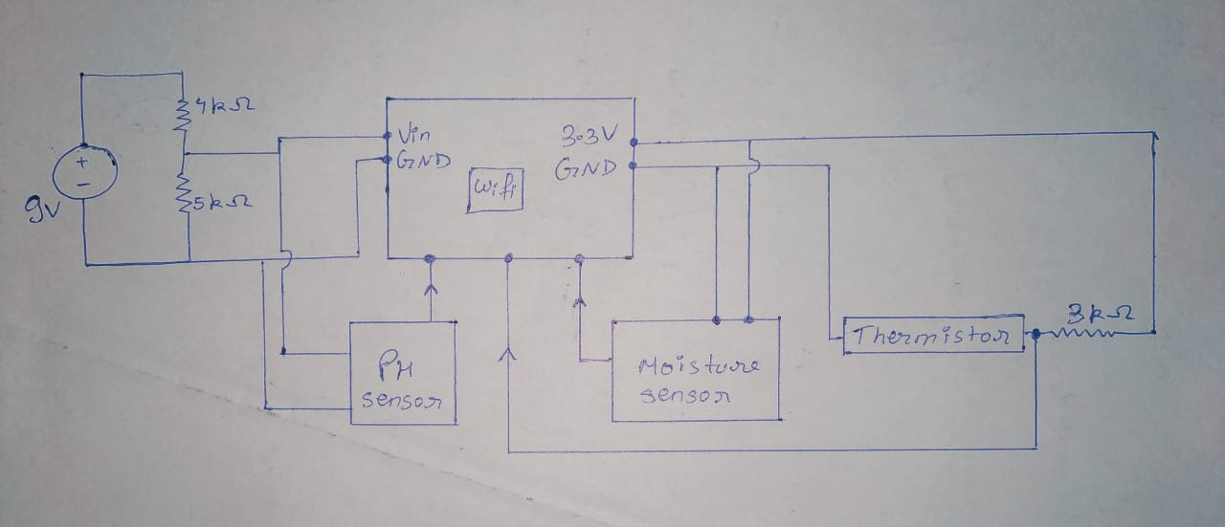
Circuit overview

Slide 9
Circuit overview
Our circuit consists of three sensors: a Capacitive Moisture sensor, a pH sensor, and a temperature sensor.
It has NodeMCU esp8266 microcontroller, which has an in-built wi-fi module that we’ll use to send the data to the cloud and fetch it on our device.
As the different sensors require different voltage levels to work, we have used voltage divider circuits using resistances of various values to distribute the required voltage to each sensor.
For example, the Capacitive sensor requires 3V as working voltage, the pH sensor requires 5V, and the temperature sensor requires 3.3V.
Since the esp8266 has 2 ground and 2 Vcc pins, the two sensors are directly connected to it, while the last one is connected with the help of wires and a battery.
A 9V battery initially powers the circuit.
We are using Blynk as our IoT platform to send the data to the cloud and fetch it on the device.
In the next few slides, we’ve written the code that we’ve used in the NodeMCU esp8266 board.

Slide 10
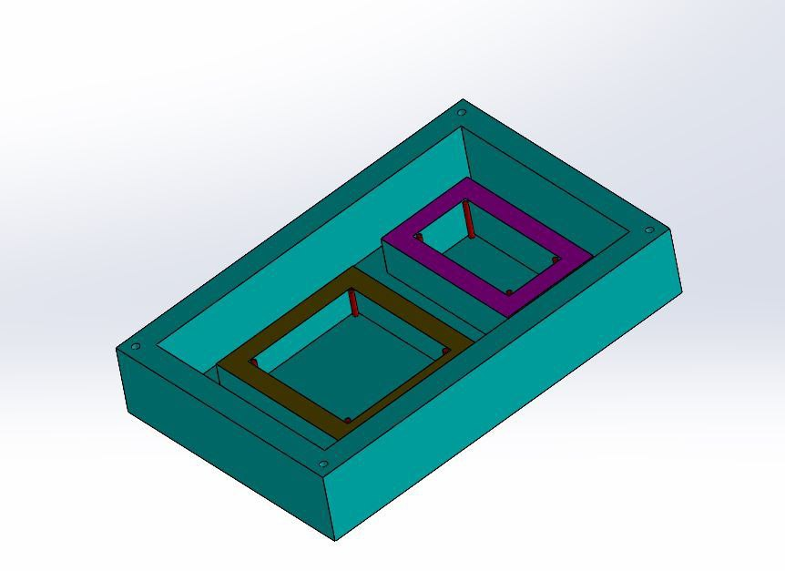
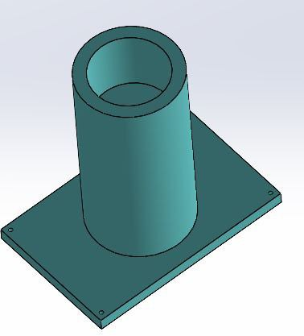
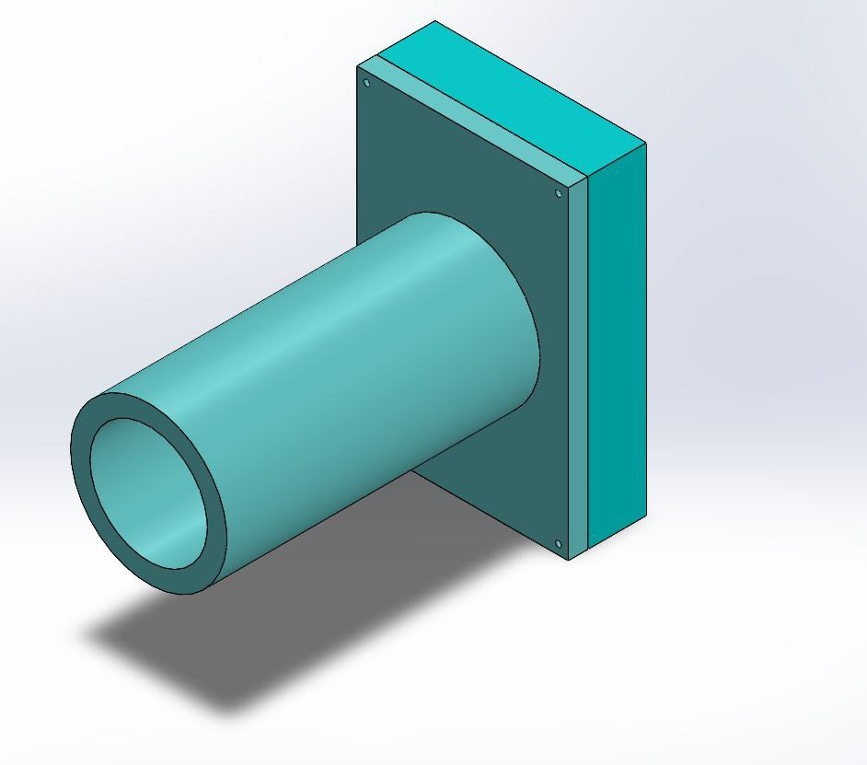
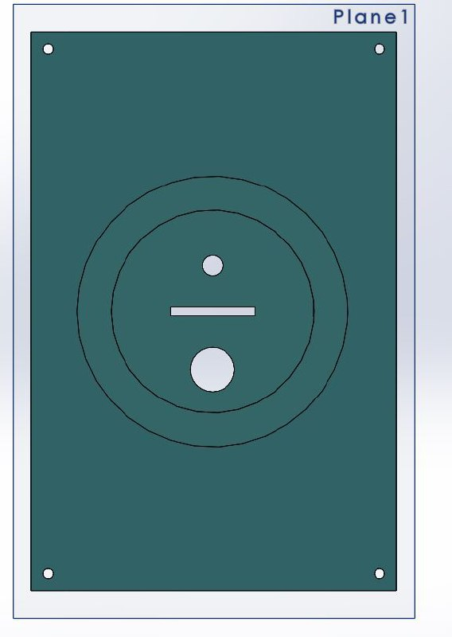
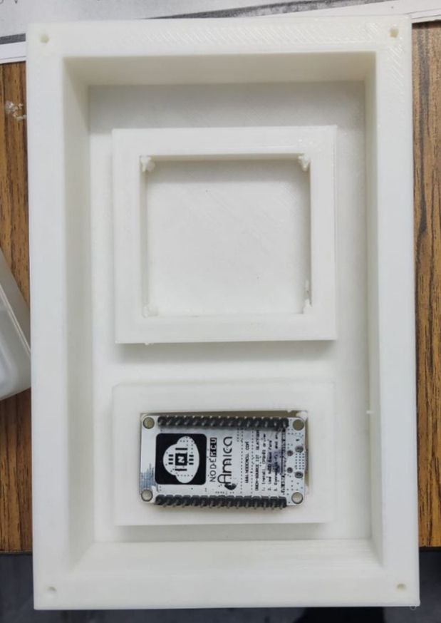
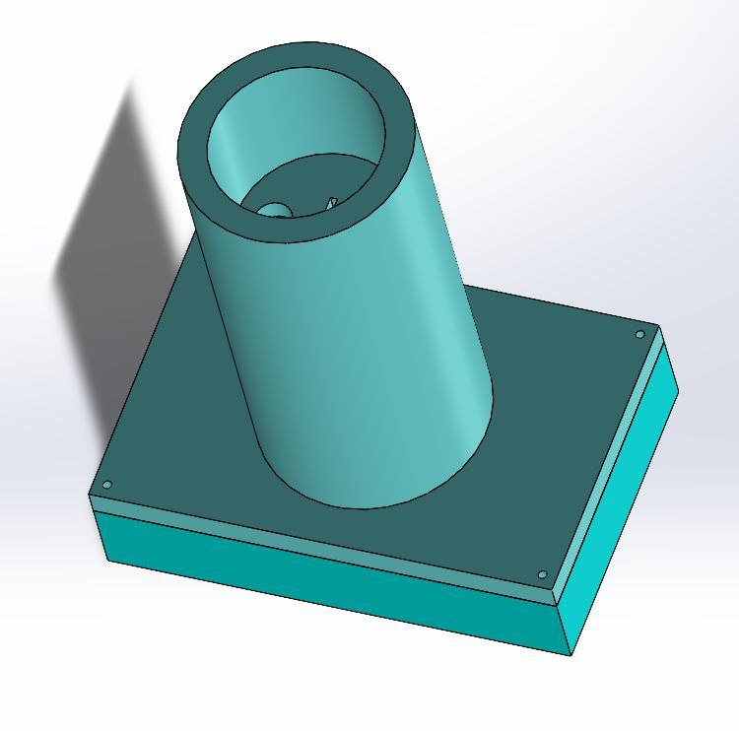
CAD MODEL

Slide 11

Code:
#define BLYNK_TEMPLATE_ID "TMPLhswNixQX"
#define BLYNK_TEMPLATE_NAME "Soil Sampling"
#define BLYNK_AUTH_TOKEN "XKE1utJtPW8NCIKAkiUq-b-fDOO75i8F"
#define BLYNK_PRINT Serial
/*#include <WiFi.h>
#include <WiFiClient.h>
#include <BlynkSimpleEsp32.h>*/
#include <ESP8266WiFi.h>
#include <BlynkSimpleEsp8266.h>
#define Offset 0.00
#define samplingInterval 20
#define printInterval 800
#define ArrayLenth 40
int pHArray[ArrayLenth];
int pHArrayIndex = 0;
int countTrueCommand;
int countTimeCommand;
boolean found = false;
int pHPin=A0;
int ThermistorPin = D0;
int MoisturePin=D1;
int Vo;
float R1 = 3000;
float logR2, R2, T;
float c1 = 1.009249522e-03, c2 = 2.378405444e-04, c3 = 2.019202697e-07;
const int AirValue = 600;
const int WaterValue = 350;
float soilMoistureValue = 0;
float soilmoisturepercent=0;

Slide 12
Code:
char ssid[] = "PrathamMobile";
char pass[] = "pratham22";
BlynkTimer timer;
float phVal() {
static unsigned long samplingTime = millis();
static float pHValue, voltage;
if(millis()-samplingTime > samplingInterval) {
pHArray[pHArrayIndex++] = analogRead(D3);
if(pHArrayIndex == ArrayLenth) {
pHArrayIndex = 0;
}
voltage = (avergearray(pHArray, ArrayLenth)*5/1023)+2;
pHValue = 3.5*voltage+Offset-14;
samplingTime = millis();
}
return pHValue;
}
double avergearray(int* arr, int number) {
int i;
int max,min;
double avg;
long amount = 0;

Slide 13
Code:
if(number <= 0) {
Serial.println("Error number for the array to averaging!/n");
return 0;
}
if(number < 5) {
for(i = 0; i < number; i++) {
amount += arr[i];
}
avg = amount/number;
return avg;
}
else {
if(arr[0] < arr[1]) {
min = arr[0];
max = arr[1];
}
else {
min = arr[1];
max = arr[0];
}
for(i = 2; i < number; i++) {
if(arr[i] < min) {
amount += min;
min = arr[i];
}
else {
if(arr[i] > max) {
amount += max;
max = arr[i];
}
else {
amount += arr[i];
}
}
}
avg = (double)amount/(number-2);
}
return avg;
}

Slide 14
Code:
void myTimerEvent()
{
//int sensorValueMoisture = analogRead(36);
float valSensorPH = phVal();
Serial.println("Analog :");
Serial.println(analogRead(D3));
Vo = (analogRead(A0));
R2 = R1 * (1023 / (float)Vo - 1.0);
logR2 = log(R2);
T = (c1 + c2*logR2 + c3*logR2*logR2*logR2);
T=T*8000;
float temperature=T;
soilMoistureValue = analogRead(D1);
Serial.println("SoilMoistureValue :");
Serial.println(soilMoistureValue);
soilmoisturepercent = map(soilMoistureValue, AirValue, WaterValue, 0, 100);
if(soilmoisturepercent >= 100)
{
Serial.println("SoilMoisturePercent :");
Serial.println("100 %");
Blynk.virtualWrite(V0,soilmoisturepercent);
}
else if(soilmoisturepercent <=0)
{
Serial.println("SoilMoisturePercent :");
Serial.println("0 %");
Blynk.virtualWrite(V0,soilmoisturepercent);
}
else if(soilmoisturepercent >0 && soilmoisturepercent < 100)
{
Serial.println("SoilMoisturePercent :");
Serial.print(soilmoisturepercent);
Serial.println("%");
Blynk.virtualWrite(V0,soilmoisturepercent);
}

Slide 15
Code:
//Blynk.virtualWrite(V1,valSensorPH);
Blynk.virtualWrite(V2,temperature);
Blynk.virtualWrite(V1,valSensorPH);
Serial.println("pH : ");
Serial.println(valSensorPH);
Serial.println("temperature : ");
Serial.println(temperature);
}
void setup()
{
// Debug console
Serial.begin(9600);
Blynk.begin(BLYNK_AUTH_TOKEN, ssid, pass);
// Setup a function to be called every second
timer.setInterval(1000L, myTimerEvent);
}
void loop()
{
Blynk.run();
timer.run();
}

Slide 16
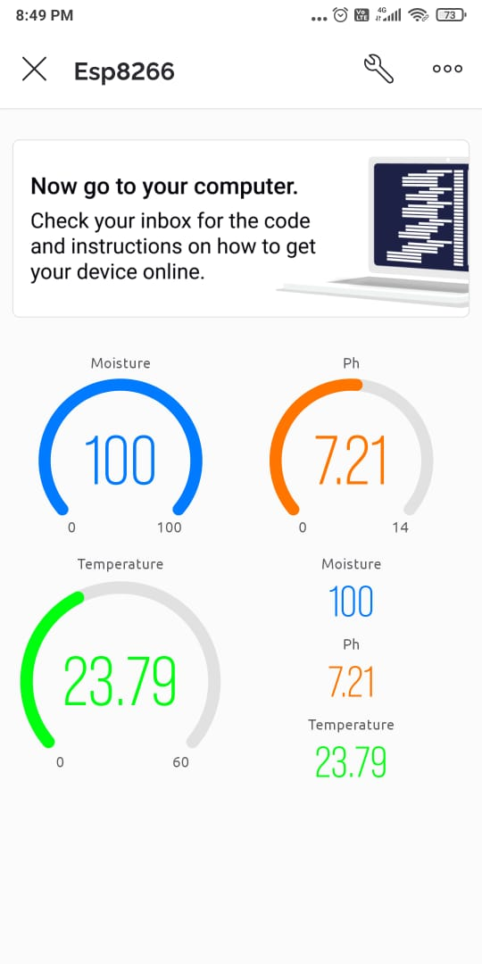
Data

Slide 17
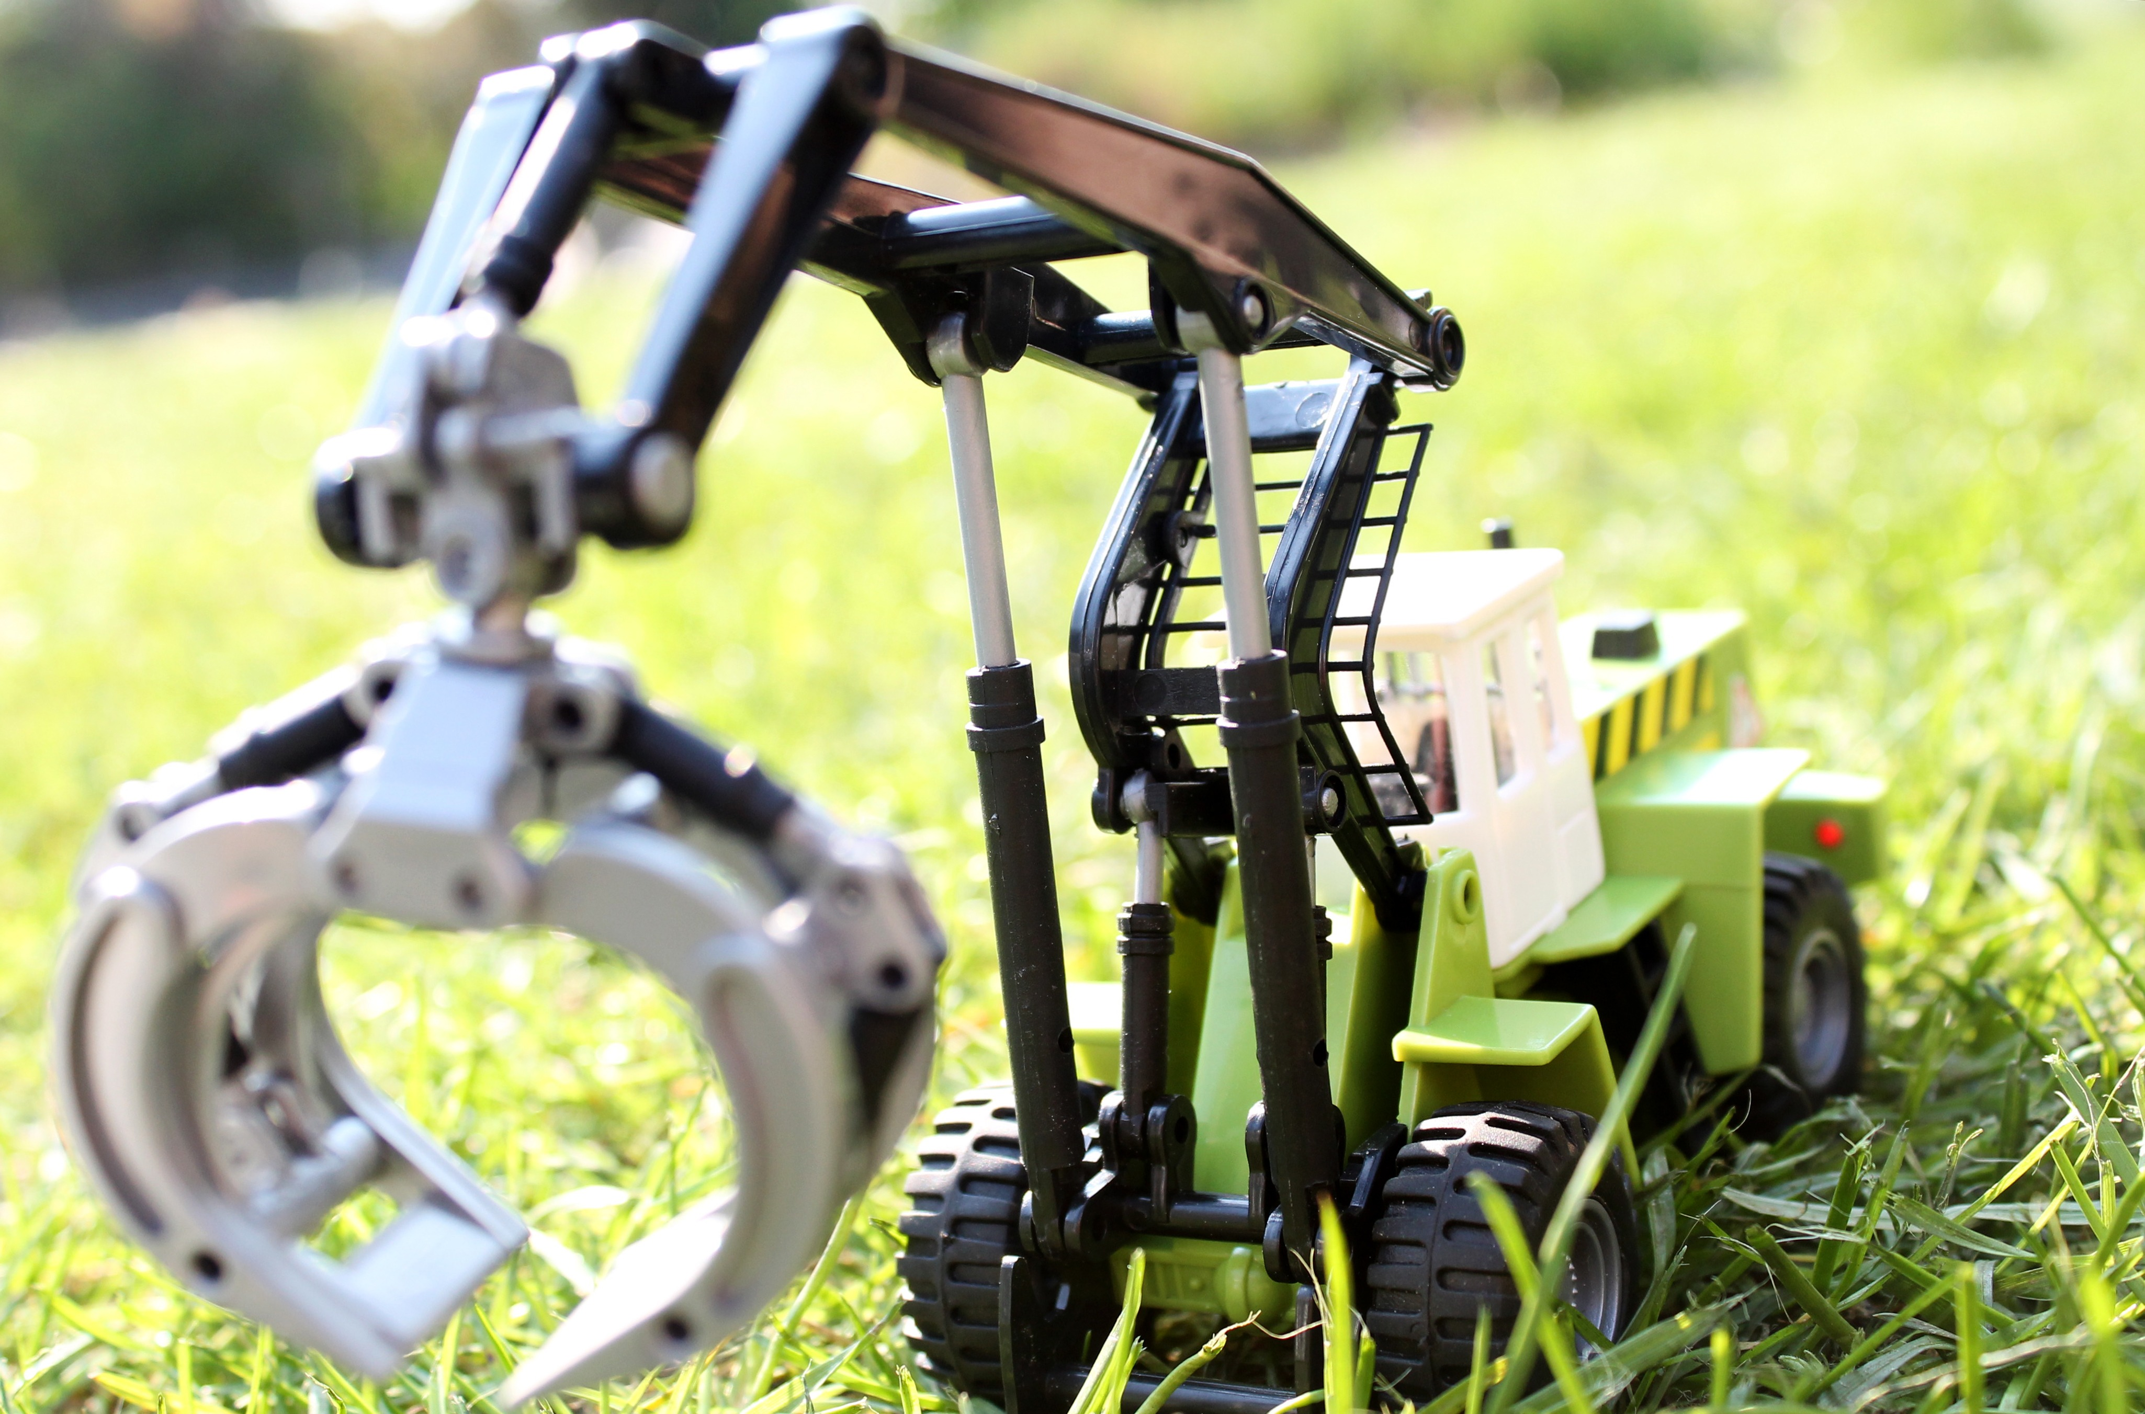
Summary
As we saw in the previous slides, we’ve been able to get data from the sensors, and using IoT, we’re sending that data to the cloud successfully. That data is easily available on our device using the Blynk IoT platform.
So this can be used from far locations as well as it uses wi-fi which makes it handy its interface is also very easy to use, so any newcomer can get accurate and necessary information about the soil very easily.

Slide 18

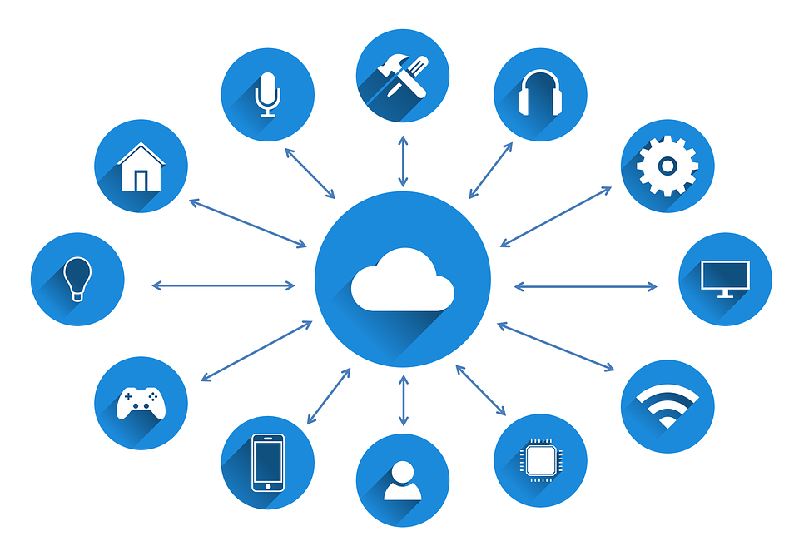
Thank you!!

